Slide 1
Historical development of the CHART project
Alberto Costa NEVES
IHO Assistant Director

Slide 2
History of chart project
It all started with a dream
Notes:
Mr. Mitsuyuki Unno, Chief Manager, Maritime Safety Team, Maritime Affairs Department, The Nippon Foundation
Mr. Shigeru Nakabayashi, JHOD – IHB – UKHO

Slide 3
History of chart project
Why we are here?
Notes:
We are part of this dream and its realization
14 years later
Not only to create capacity but to enable its happening
Providing training and networking

Slide 4
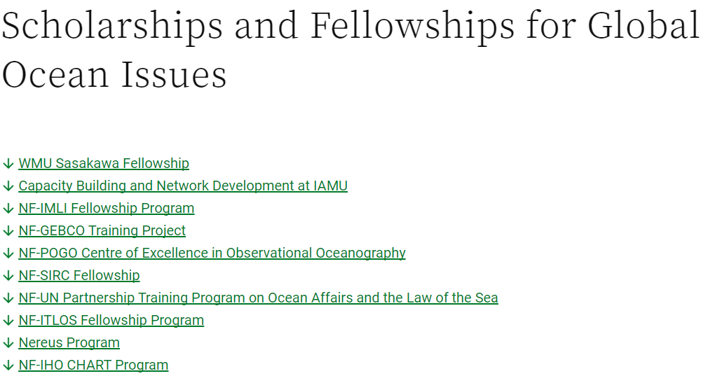
History of chart project

Slide 5
History of chart project
2008 | MOU between IHO and JHA (financially supported by NF) | 1st secondment (Mr. Shigeru NAKABAYASHI)
2009 | Japan Capacity Building Project started (1st): 6 trainee
2010
2011 |  | 2nd secondment (Mr. Satoshi YAMAO)
2012
2013 | MOU between IHO and NF agreed
2014 | NF-IHO CHART Project started (2014-2016): 7 trainee
2015 |  | 3rd secondment (Dr. Kentaro KANEDA)
2016 | 1st Alumni Workshop (Bangkok)
2017 | NF-IHO CHART project 2nd phase started (2016-2019)
2018 | Mr. Jeff Bryant retired | 4th secondment (Mr. Naohiko NAGASAKA)
2019 | 2nd Alumni Seminar (Singapore)

Slide 6
History of chart project
Who are we, the Alumni?

Slide 7
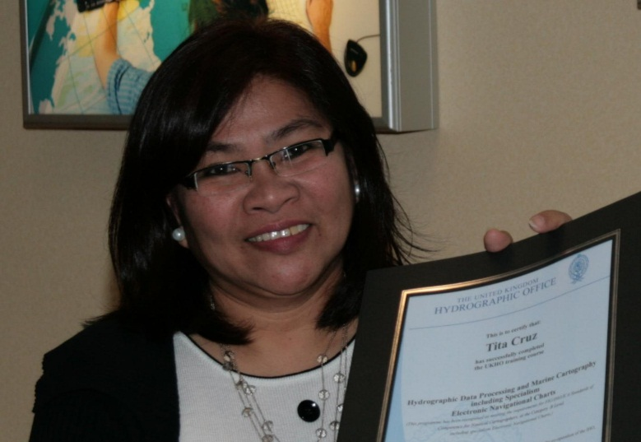
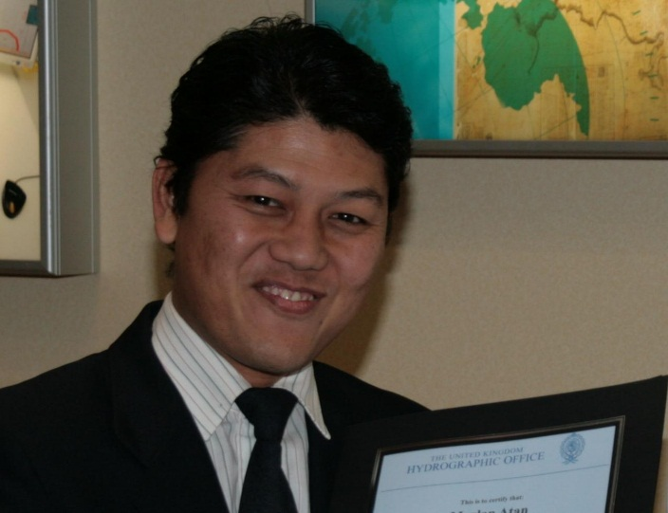
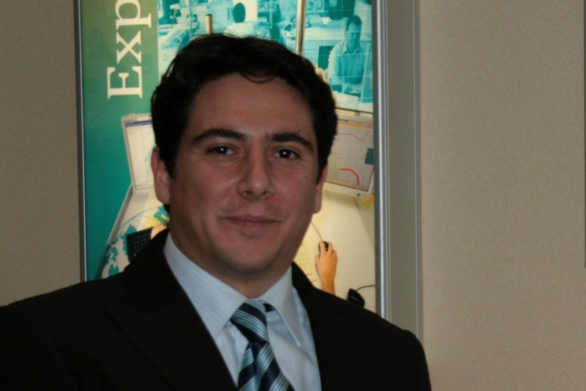
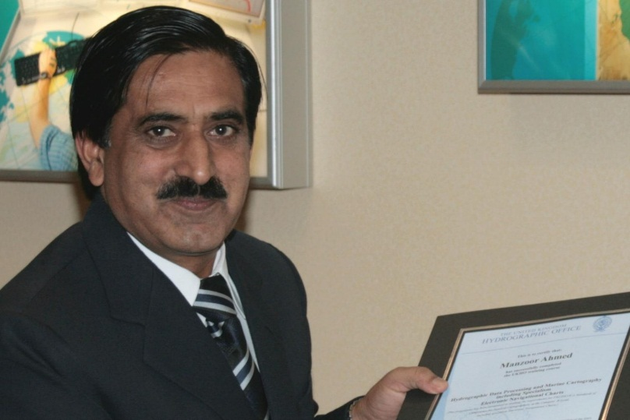
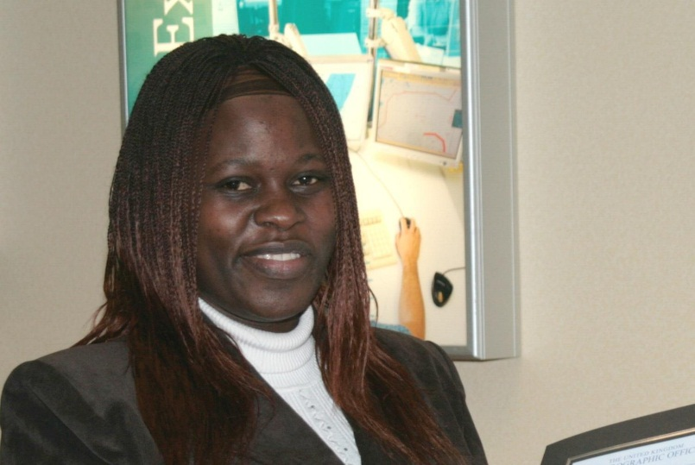
2009
Notes:
We are 10 years of investment in women and men

Slide 8
2010
Notes:
Nautical cartographers mostly from developing countries

Slide 9
2011
Notes:
We are building the national infrastructure of our countries

Slide 10
2012
Notes:
We are creating opportunities for equality in our countries

Slide 11
2013
Notes:
Creating conditions for safe navigation worldwide

Slide 12
2014
Notes:
Ensuring that the hydrographic knowledge is sustainably used by our countries

Slide 13
2015
Notes:
We are part of a global network of professionals that produce nautical charts, products and services

Slide 14
2016
Notes:
We contribute to the social development of people across the world

Slide 15
2017
Notes:
We ensure the use of Standards in harmonized nautical charts

Slide 16
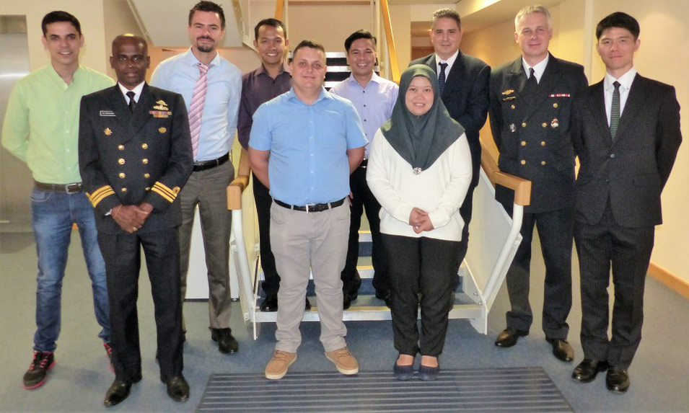
2018
Notes:
We are women and men that contribute to the blue economy

Slide 17
2019
Notes:
We contribute to the sustainable use and protections of oceans, seas and inland waters

Slide 18
History of chart project
Level of interest for the CHART education

Slide 19
Applicants to the programme

Slide 20
History of chart project
Where are we from?

Slide 21
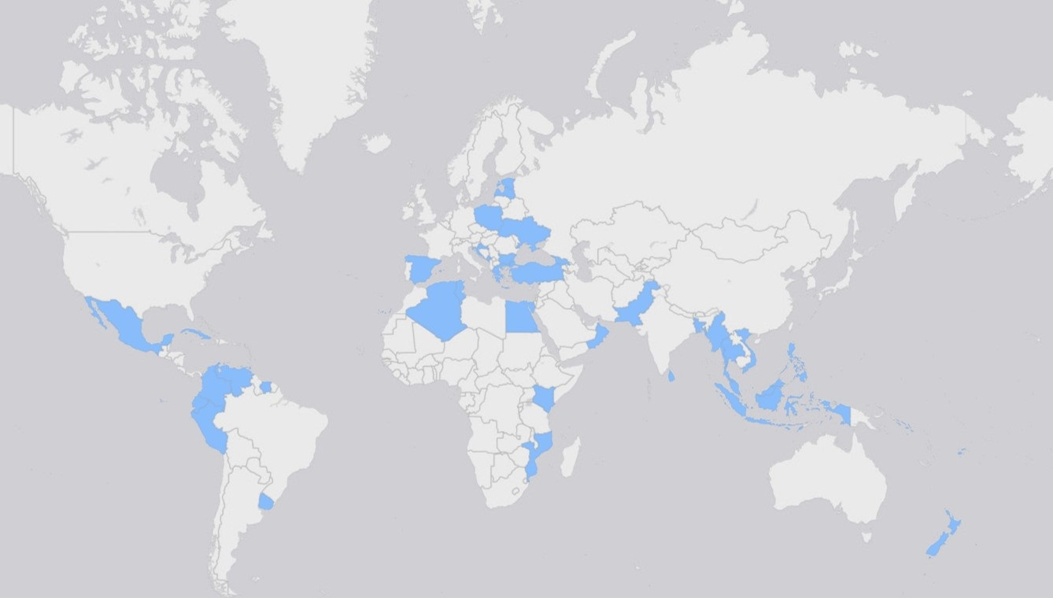
GEOGRAPHICAL DISTRIBUTION (ALUmNI)

Slide 22
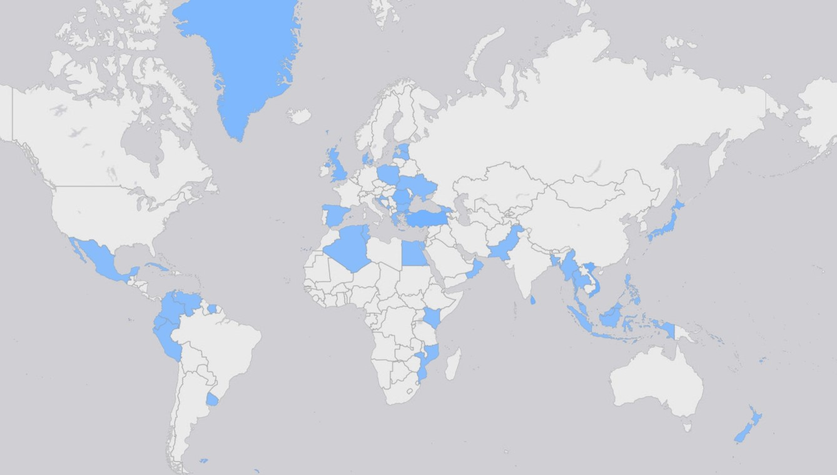
GEOGRAPHICAL DISTRIBUTION
(incl. extended alumni)

Slide 23
GENDER DIVERSITY

Slide 24
average age of trainees at time of the course

Slide 25
consistent career path as cartographers

Slide 26
History of chart project
Conclusion

Slide 27
conclusion
Alumni have:
sustained a long career path in hydrographic offices
reviewed the whole charting schemes in some offices
taken decision making roles for charting and beyond
engaged as teachers and instructors in their countries
have significantly improved the chart quality and coverage worldwide (next presentation)

Slide 28
conclusion
The CHAR Project is a case of success.

Slide 29
Thank you.
Alberto Costa NEVES
IHO Assistant Director
alberto.neves@iho.int

